Slide 1
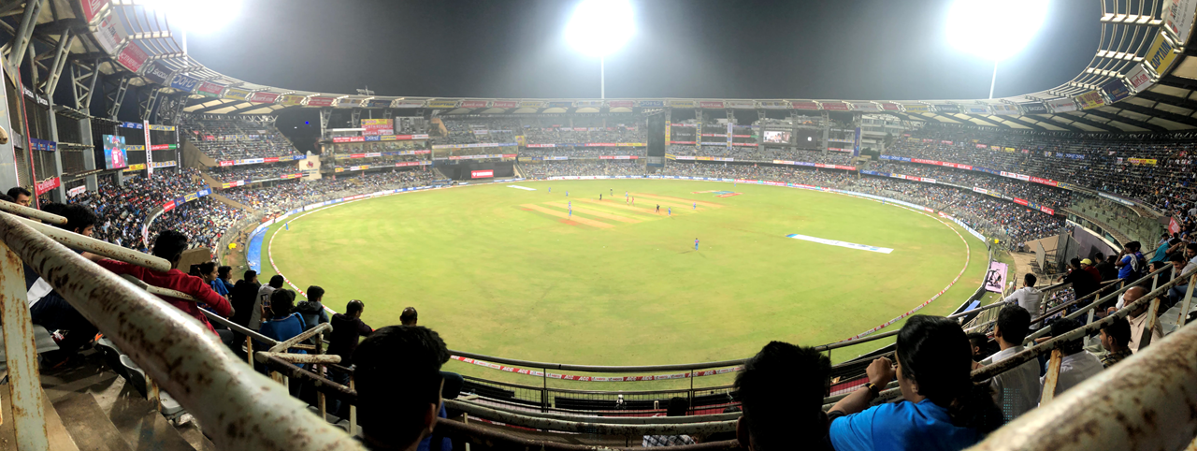
Live Cricket Scoring
Scorify v1.0

Slide 2
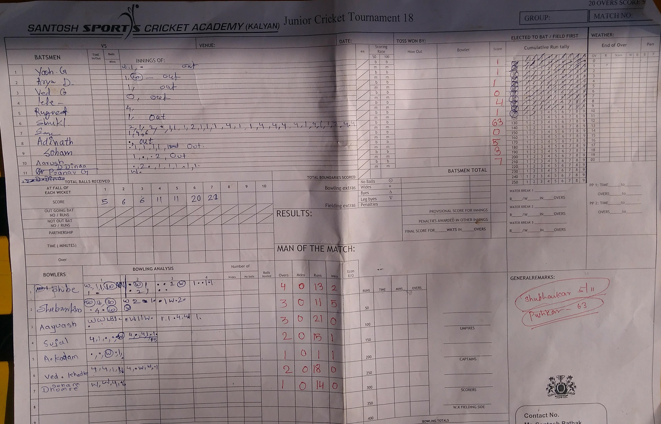
Introduction
In cricket, a scorer is someone appointed to record all the events taking place before, during and after the match. It is possible to record this using a pen and plain paper.
On the day of the match there are multiple manual calculations to calculate such as batting analysis for each batsman, bowling analysis for each bowler, etc.
Hence, the purpose behind making this project will help the scorers to make their task easy with a click of a button.

Slide 3

Objectives
To reduce multiple manual calculations during the match such as net run rate, batsman’s analysis, bowler’s analysis.
Building an interface that is user-friendly
To provide ball-by-ball update of the match.
To provide detailed scorecard.

Slide 4

Requirements
Functional Requirements
Register
Login
Ball-to-ball Scoring
Professional Scorecard
Responsive Design
Non-Functional Requirements:
Usability
Reliability
Flexibility
Software:
Frontend: HTML, CSS, JavaScript
Backend: PHP
Database: MySQL

Slide 5
References
Websites:
https://cricheroes.in/
https://play-cricket.ecb.co.uk
https://www.php.net/manual/en/langref.php/
https://www.tutorialspoint.com/
https://www.lucidchart.com/
Reference Books:
Software Engineering, “Ian Somerville”, 8th Edition, Pearson Education.
Database System Concepts, “Henry F. Korth, Abraham Silberschatz. S.Sudarshan” McGrawHill 4th Edition
The Unified Modeling Language Reference Manual, 2nd Edition, “James Rumbaugh, Ivar Jacobson, Grady Booch”

Slide 6


